Slide 1
APA

Slide 2
Which is correct…
Chapter 1: Introduction
The quick brown fox jumped over …
Introduction
The quick brown fox jumped over …
The quick brown fox jumped over …
Introduction
The quick brown fox jumped over …

Slide 3
Which is correct…
Chapter 1: Introduction
The quick brown fox jumped over …
Introduction
The quick brown fox jumped over …
The quick brown fox jumped over …
Introduction
The quick brown fox jumped over …
Because the introduction is clearly identified by its position in the manuscript, it does not carry a heading labeling it the introduction. (section 2.05)

Slide 4
Correlation

Slide 5
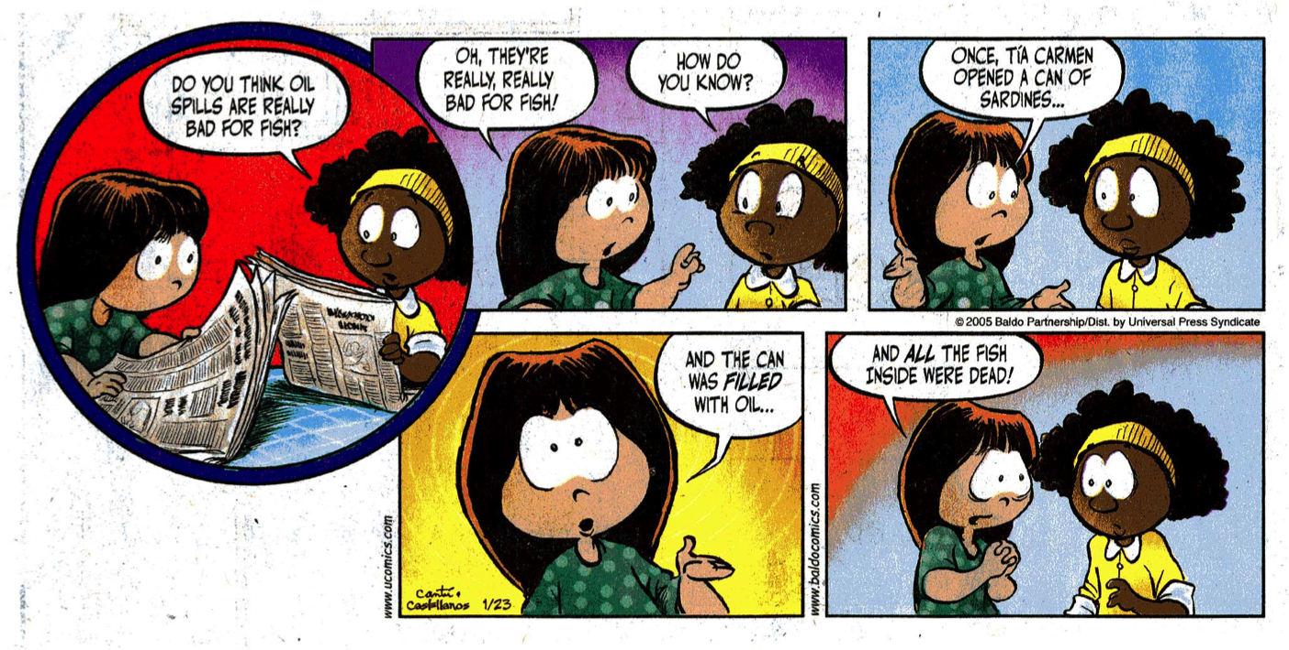
Correlation: Measure of the degree of correspondence between two or more variables
Oh, they’re really, really bad for fish!
How do you know?
Once, Tia Carmen opened a can of sardines…
Do you think oil spills are really bad for fish?
And all the fish inside were dead!
And the can was filled with oil…
0

Slide 6
Measuring Variable Relationships
Students with more referrals have lower GPAs.
Variables
Referrals and grade point average
How strongly are these two variables linked?
How about if someone said: Middle school students who dress poorly come from lower SES families.

Slide 7
Measuring Variable Relationships
The reason you are more confident about referrals and GPA is that the two variables are more closely related than dress and SES.
It is harder to think of examples where referrals and GPA wouldn’t be related.
When two variables show this strong association, they have a high or strong correlation.

Slide 8
Measuring Variable Relationships
How about the relationship of hearing loss and age in men?
There is probably a strong correlation between these two variables.
The relationship is strong and directionally the same.

Slide 9
Measuring Variable Relationships
Age and hearing loss:
more hearing loss/higher age
less hearing loss/lower age
Referrals and GPA:
fewer referrals/higher GPA
more referrals/lower GPA
These sets of variables may have the same strength of association but they are linked in opposite directions.

Slide 10
Correlation Coefficient
A single number that represents the strength and direction of a relationship between two variables within the same sample.

Slide 11
Correlation

Slide 12
Correlation—Positive
Ray
Years of Teaching
Megan
Age

Slide 13
Correlation—Positive
Years of Teaching
Age

Slide 14
Correlation—Positive
0.88
Years of Teaching
Age

Slide 15
Correlation—Negative
-0.71
Sick Leave Days
Years of Teaching

Slide 16
Correlation—Negative
-0.71
Sick Leave Days
Years of Teaching

Slide 17
Correlation

Slide 18
Correlation—None
Class Size
-0.07
Sick Leave Days

Slide 19
Correlation Range
-1.0
-.7
-.3
0
.3
.7
1.0
Variables change in opposite directions
Variables change in the same direction
No Correlation
High
Moderate
Low or Weak
Moderate
High

Slide 20
Correlation Practice
Download Pinecrest Data
Produce scatterplots and correlations for all of the tests and GPAs (all 5).
Correlation matrix
What do you know?

Slide 21
Correlation Critical Values
Correlations could occur by chance just like any other statistical observation.
How strong do correlations need to be before we are confident they didn’t occur by chance?
It depends on the group size.

Slide 22
Correlation Critical Values
With large groups, correlations are unlikely to occur randomly even if they are relatively weak correlations.
With small groups, it is more difficult to know if correlations could be a random occurrence even if they are relatively strong.
Critical value table

Slide 23
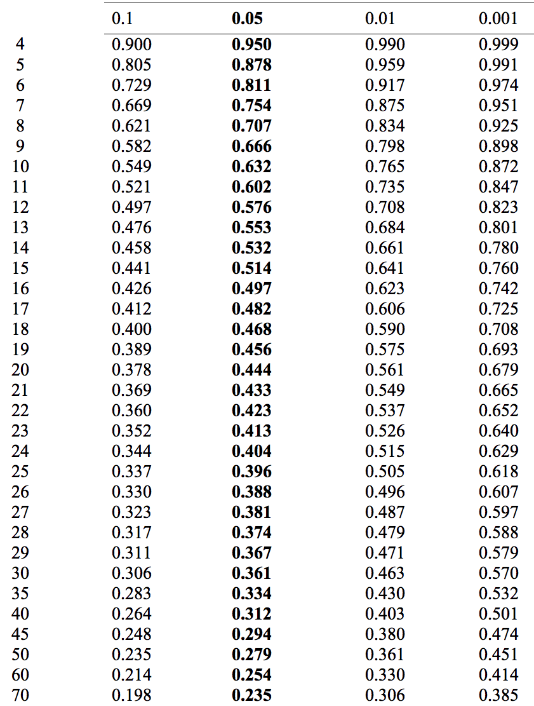
Judging the Likelihood of Random Occurrence
Number of Matched Pairs
Level At Which Computed Correlations Are Significant
For now look at the 0.05 column
At group size 40 correlations must be larger than .3

Slide 24
Reporting Correlations
In the results section list the sample size, two variables compared and the two decimal point correlation number.
“In the comparison of number of referrals and gpa for 36 students the correlation was .73.”
Don’t make a correlation table unless you have more than two variables that are being compared.

Slide 25
Correlation Table
 | Var1 | Var2 | Var3 | Var4
Var1 | 1 | 0.67 | 0.32 | -0.44
Var2 | 0.67 | 1 | -0.02 | 0.67
Var3 | 0.32 | -0.02 | 1 | 0.32
Var4 | -0.44 | 0.67 | 0.32 | 1

Slide 26
Correlation Table
 | Var1 | Var2 | Var3 | Var4
Var1 |  | 0.67 | 0.32 | -0.44
Var2 | 0.67 |  | -0.02 | 0.67
Var3 | 0.32 | -0.02 |  | 0.32
Var4 | -0.44 | 0.67 | 0.32

Slide 27
Correlation Table
 | Var1 | Var2 | Var3 | Var4
Var1
Var2 | 0.67
Var3 | 0.32 | -0.02
Var4 | -0.44 | 0.67 | 0.32

Slide 28
Correlation Table
 | Var1 | Var2 | Var3
Var1
Var2 | 0.67
Var3 | 0.32 | -0.02
Var4 | -0.44 | 0.67 | 0.32

Slide 29
Correlation Table
 | Var1 | Var2 | Var3
Var2 | 0.67
Var3 | 0.32 | -0.02
Var4 | -0.44 | 0.67 | 0.32

Slide 30
Correlation Table

Slide 31
APA Tables
An informative table supplements—rather than duplicates—the text. (section 5.10)
Tables should be integral to the text but should be designed so that they can be understood in isolation. (section 5.07)
Be selective in choosing how many graphical elements to include in your paper. … Information that used to be routinely presented in tables is now routinely presented in text. (section 5.03)

Slide 32
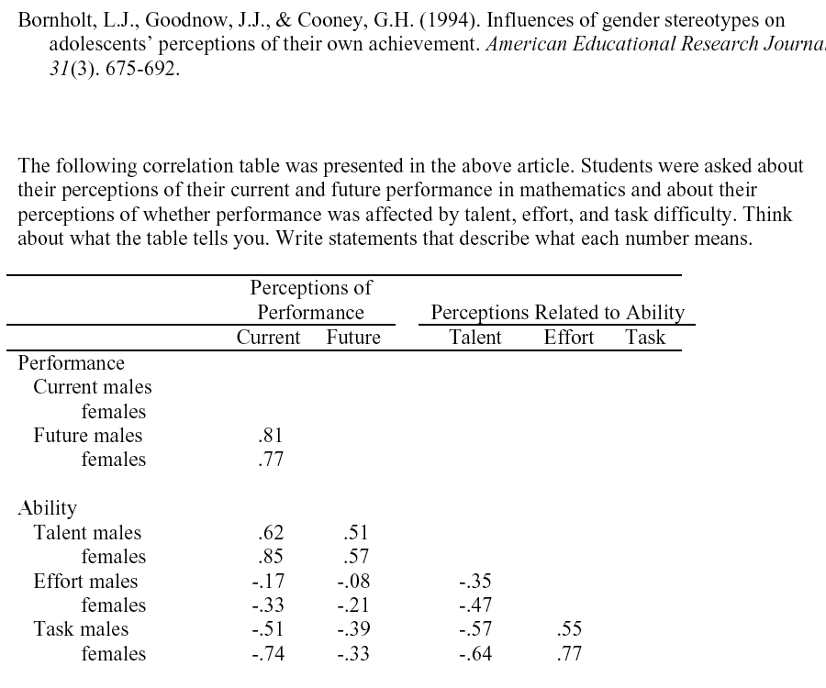
l.
Current Performance—How well do you think you will do in math this year? (Not at all well - Very well) Future Perfor.—How well do you think you will do in math in senior high? (Not at all well - Very well) Talent—Do you perceive yourself to be talented in math? (Not at all - Quite a lot) Effort—How hard do you have to try to get good marks in math? (Little - A lot) Task—In general, how hard is math for you? (Very easy - Very hard)

Slide 33
Correlation Caution
As ice cream sales increase so do drowning deaths.
Any two sets of numbers can be correlated.
Sometimes there are one or more intervening variables that explain the relationship.

Slide 34
Correlation Caution
In general students who are more motivated have better GPAs.
More motivated—higher grades; Less motivated—lower grades.
We don’t know that motivation causes improved performance or that performance causes motivation. Maybe neither causes the other.

Slide 35
In a study of the influence of teachers on student achievement, researchers discovered a correlation of .78 between the age of students’ last math teacher and their score on the math portion of the SAT. Apparently older teachers give students better content or skills for doing well on these tests than their younger counterparts.
Correlations are not causation. Look for alternative explanations.

Slide 36
In the late 1960s a Stanford researcher was investigating sunspots. He noticed quite accidentally that during times of higher sunspot activity that Beatles’ songs seem to be playing more frequently on the radio in his lab. He did an analysis and discovered a .67 (moderate to high) correlation between sunspot activity and Beatles recordings position on the charts.
Correlations need to make sense. There needs to be a reason to believe that a relationship exists between variables independent of the calculation of the correlation. Where is the literature?

Slide 37
A Slightly More Advanced Look at Correlations
a computational logic point of view

Slide 38
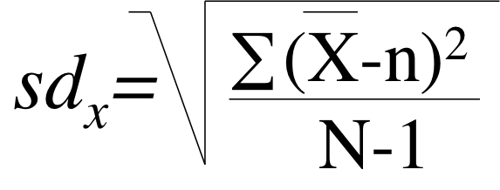
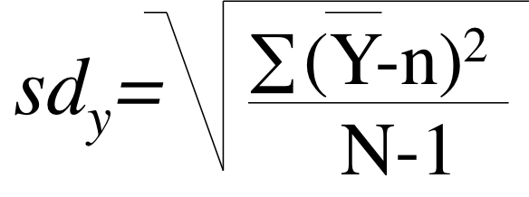
Standard Deviation
Remember standard deviation is the square root of the variance

Slide 39
Combined Variation
Instead of squaring the standard deviation to show the variance, the combined variance is the two standard deviations multiplied together (sd_{x})(sd_{y})

Slide 40
Individual Variation
Sally
Bob
The combined variation for each individual can be shown as well. What is the combined distance that each individual is from the mean of the two variables? (X-n)(Y-n)

Slide 41
Variance
With interval variables, variance is measured by computing the average squared distance that every score is from the mean.
We did this with sum of squares divided by degrees of freedom.
∑(X-n)²
sum of squares
N-1
degrees of freedom

Slide 42
Variance
∑(X-n)²
∑(X-n) (X-n)
=
N-1
N-1
Covariance
∑(X-n) (Y-n)
Individual variations averaged
N-1

Slide 43
Shared Variance
Correlation looks at 2 variables at the same time and shows how strongly the two variables are associated.
The strength of the association is explained by showing how much of the variance in one variable is responsible for the total variance in the model.
What is the shared variance of the two variables or the covariance?

Slide 44
Shared Variance
Covariance represents the degree to which two variables behave in a parallel manner. If you know how one variable behaves, how much do you know about the second’s behavior?
Variance of Variable B
Variance of Variable A

Slide 45
Covariance
These could be different sides of the means so the product could be positive or negative
∑(X-n) (Y-n)
N-1
Correlations can be positive or negative.

Slide 46
Ratio of Variance
The product of the standard deviations represents all the variance in the two variables.
Covariance represents the average of how each individual varies on the two variables.
∑(X-n) (Y-n)
N-1
(sd^{x})(sd^{y})

Slide 47
Ratio of Variance
If the covariance gets close to the total variance the ratio gets closer to 1 (or -1). This will happen when the two variables behave in similar manner—one close to the mean/the other close to the mean, or one far from the mean/the other far from the mean.
∑(X-n) (Y-n)
N-1
(sd^{x})(sd^{y})

Slide 48
Correlation
Covariance divided by the product of the two standard deviations gives the correlation
Formally this is called a Pearson product-moment correlation coefficient
Pearson’s r

Slide 49
What if …
Compute the correlation of the following two variables:
Ordinal attitude inventory
Index of representative behaviors

Slide 50
Non-interval data
Scores have to be converted to ranks.
Then compute a Pearson’s r
This is referred to as a:
Spearman rank correlation coefficient
Spearman’s rho
r_{s}

Slide 51
Excel data set: Pacific Crest

Slide 52
Why Scatterplots?
Outliers, non-linear data, and other anomalies

Slide 53
Why Scatterplots?
Outliers, non-linear data, and other anomalies

Slide 54
Why Scatterplots?
Outliers, non-linear data, and other anomalies

Slide 55
Linear Regression
Predicting with Correlation

Slide 56
Linear Regression
Linear regression examines the predictive relationship of two variables
As the name implies, to begin with the assumption is that the relationship is linear, just like correlation

Slide 57
r = .90

Slide 58
r = .90

Slide 59
r = .90
Least Squares

Slide 60
r = .90

Slide 61
r = .90

Slide 62
r = .90

Slide 63
r = .90
r ² = .81
42.57
Predicted value
Predicted value
27.27
Known value
Known value

Slide 64
r ² = .81
r ² is the shared variance of the two variables.
It is read as a percent. It represents your confidence that the y prediction will be correct.

Slide 65
EZAnalyze Linear Regression
Dependent Variable (the thing you want to predict) is variable 1
Independent Variable (the thing you are using to predict the other variable) is variable 2
Do a correlation and ask for the trendline
Right click on the trendline and select Format Trendline
Turn on Display Equation on chart and Display R-squared on chart.
Put in the range of the independent variable
Solve for y for each possible x

